Slide 1


PHOTOGRAPHS OF Wa state
Dept. of corrections-
PRISON PARENT-CHILD VISIT SPACEs
Compiled by WDA’S Incarcerated Parents Project

Slide 2
Women’s DIVISION
As of November 2025, there is only one women’s prison in Washington State.

Slide 3
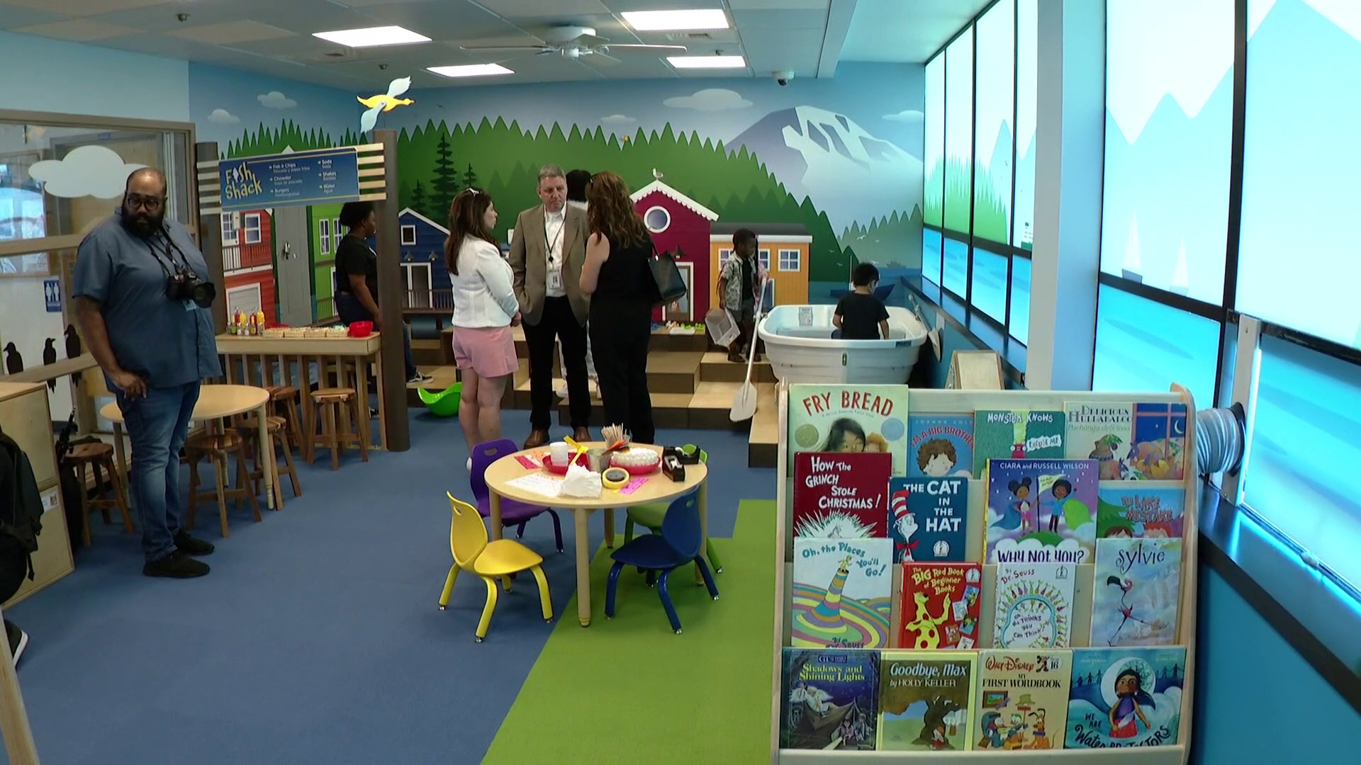
Women’s DIVISION
Medium, Close, & minimum
Washington Corrections Center for Women (Gig Harbor, WA)
Courtesy of King 5.com, 2024
Notes:
Pierce County
Capacity: 738
Opened: 1971

Slide 4
Men’s DIVISION
There are nine men’s prisons in Washington State: three in Eastern Washington and six in Western Washington.

Slide 5
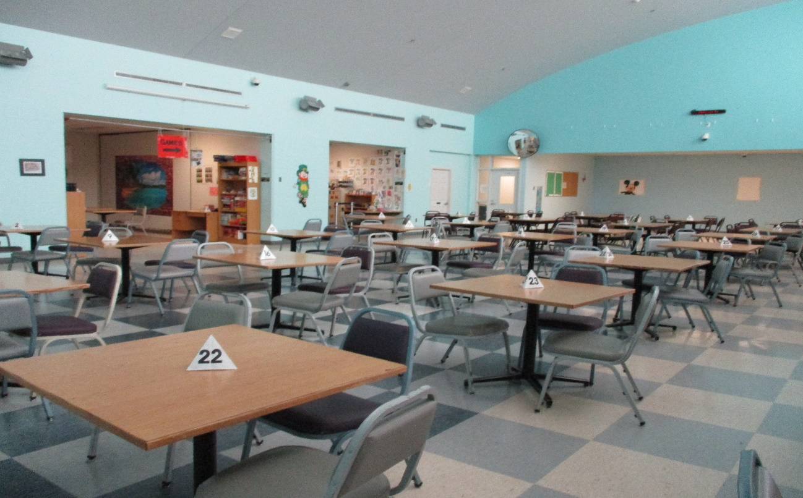
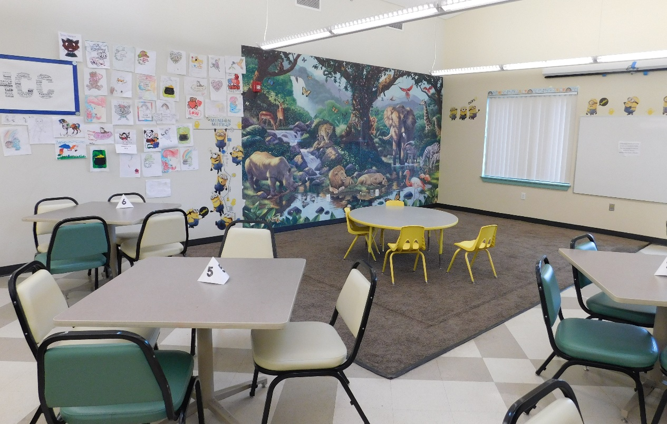
Men’s DIVIsION-eastern Washington
Medium, Close, & minimum
Airway Heights Corrections Center (Airway Heights, WA)
Corrections Center
Minimum Security Unit
Courtesy of WA DOC Family Services Division, 2018
Notes:
Spokane County
Capacity: 2,258
Opened: 1992

Slide 6
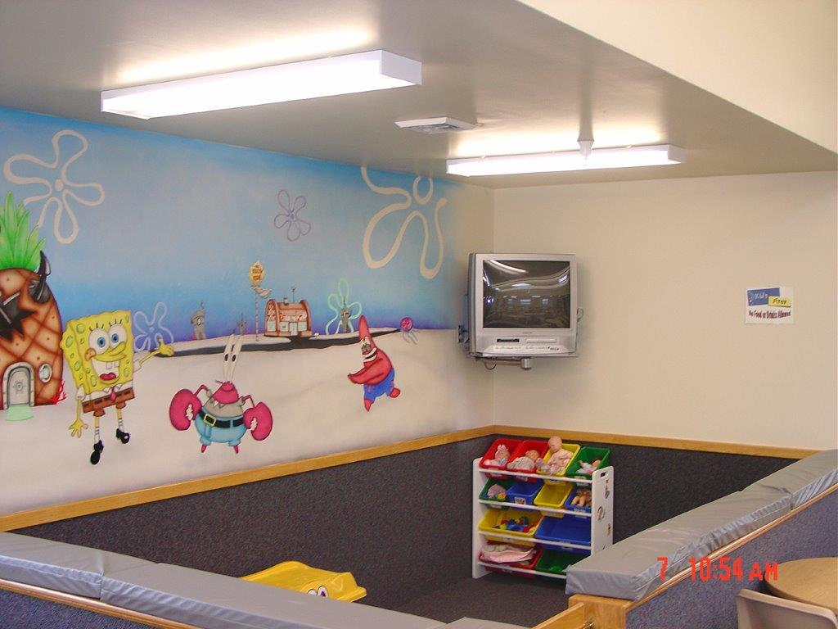
Men’s DIVISION-eastern Washington
Medium, Long-Term Minimum, & Minimum
Coyote Ridge Corrections Center (Connell, WA)
Courtesy of WA DOC Family Services Division, 2018
Notes:
Franklin County
Capacity: 2,468
Opened: Minimum-1992, Medium-2009

Slide 7
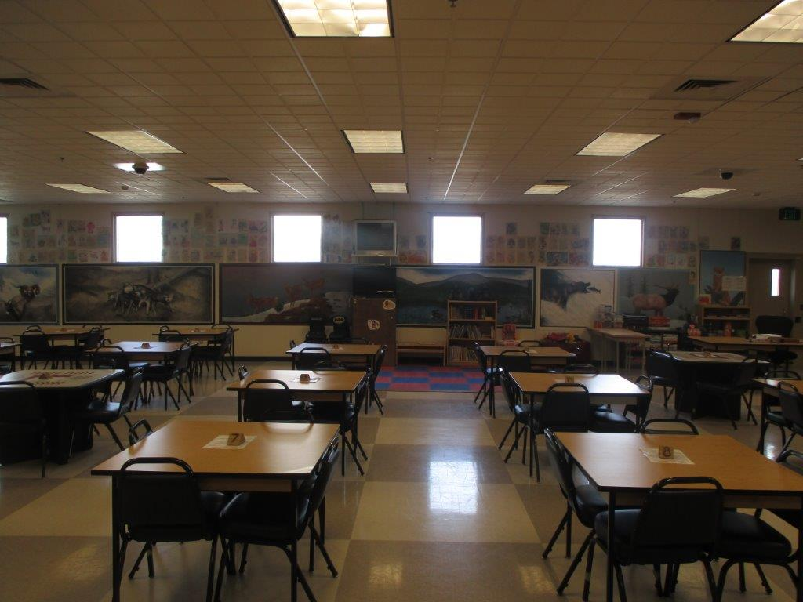
Men’s DIVISION-eastern Washington maximum, close, medium, & minimum
Washington State Penitentiary (Walla Walla, WA)
Courtesy of WA DOC Family Services Division, 2018
Notes:
Walla Walla County
Capacity: 2,439
Opened: 1886

Slide 8
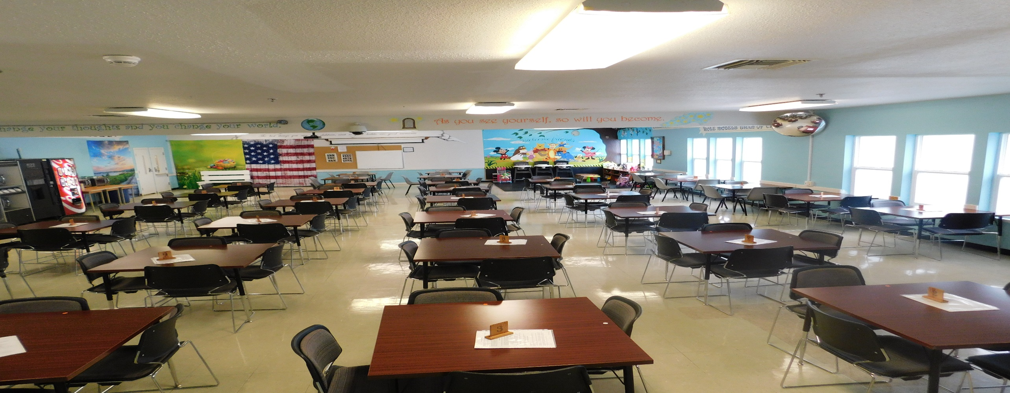
Men’s DIVISION-western Washington minimum
Cedar Creek Corrections Center (Littlerock, WA)
Courtesy of WA DOC Family Services Division, 2018
Notes:
Thurston County
Capacity: 480
Opened 1954

Slide 9
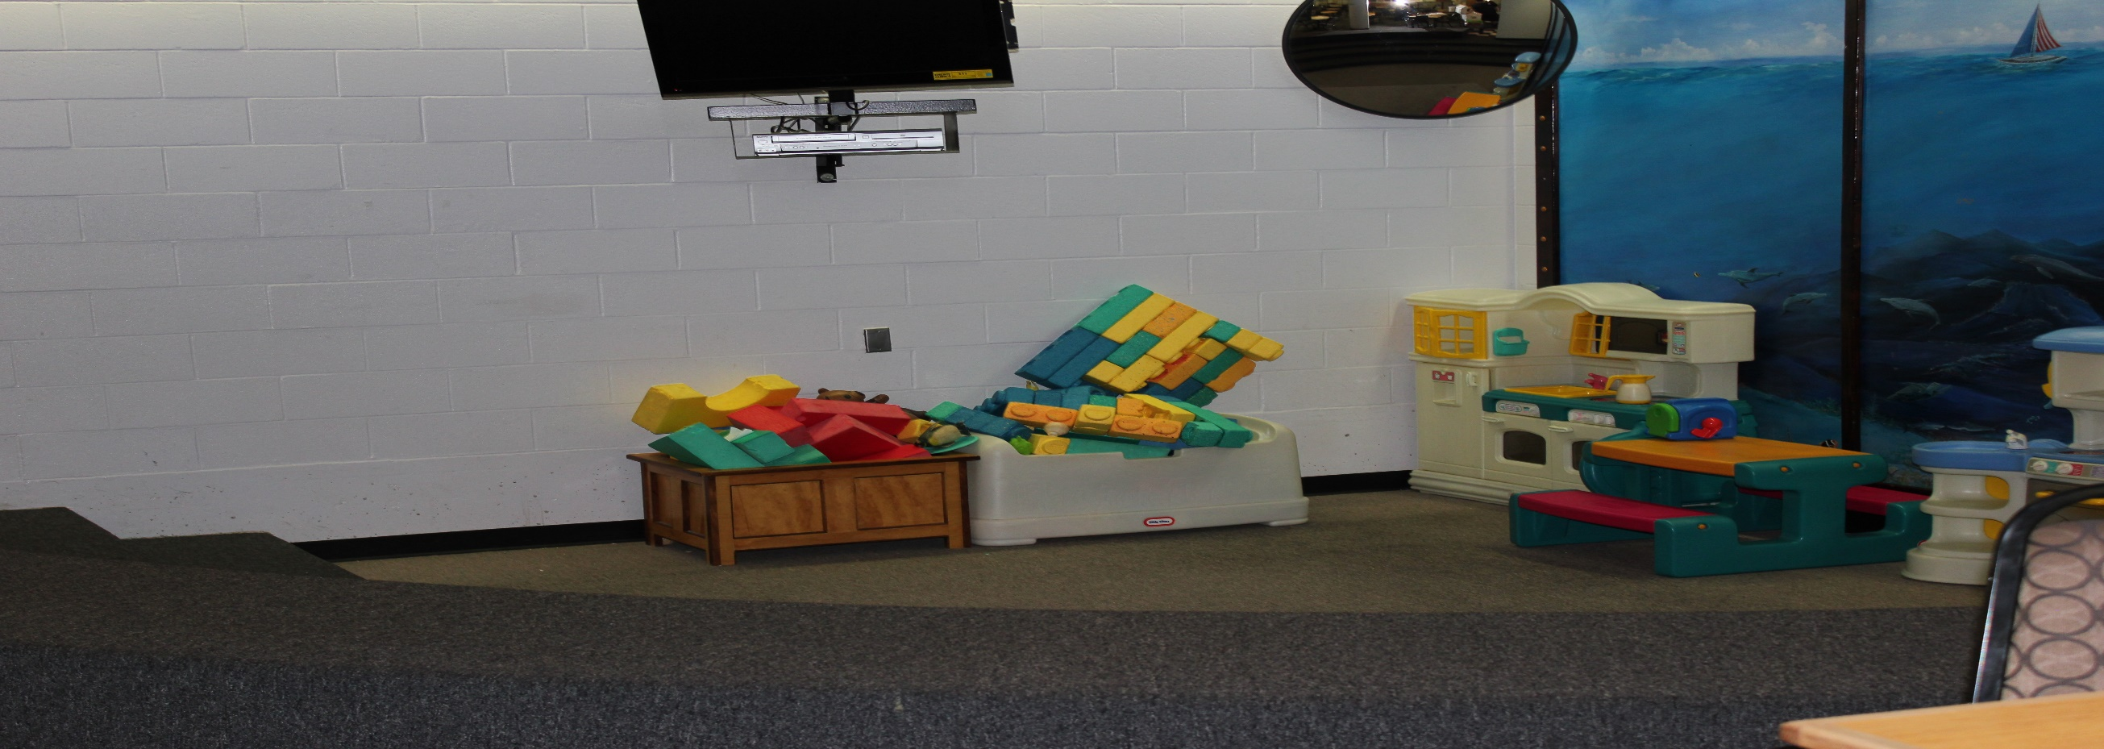
Men’s DIVISION-western Washington maximum, Close, & Medium
Clallam Bay Corrections Center (Clallam Bay, WA)
Courtesy of WA DOC Family Services Division, 2018
Notes:
Clallam County
Capacity: 858
Opened 1985

Slide 10
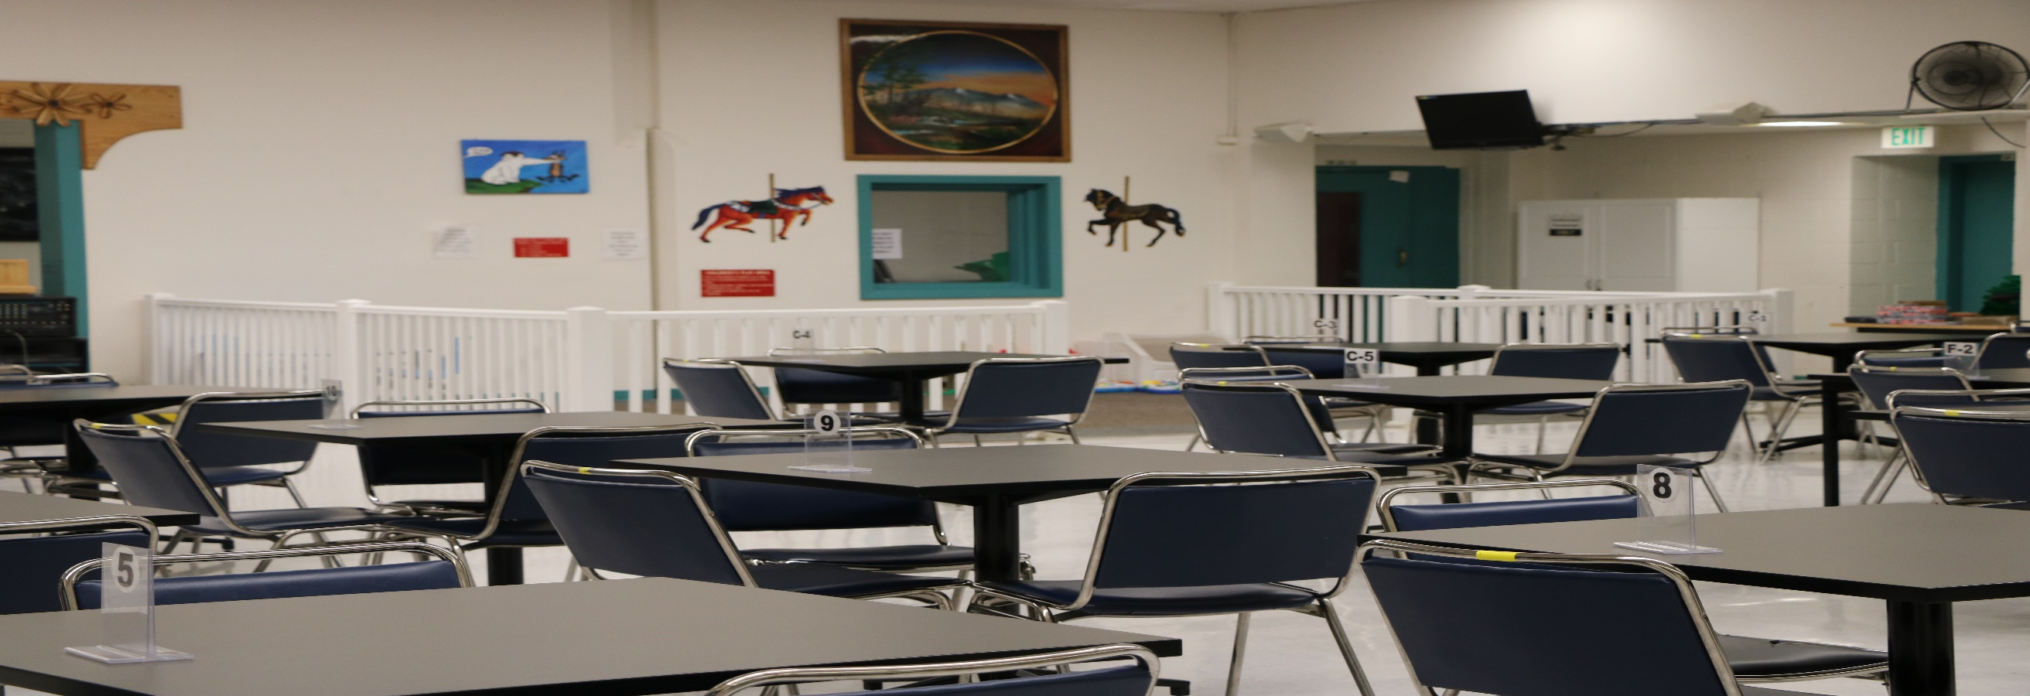
Men’s prisons-western Washington maximum, Close, medium, & minimum
Monroe Corrections Complex (Monroe, WA)
Courtesy of WA DOC Family Services Division, 2018
Notes:
Snohomish County
Capacity: 2,400
Opened 1910

Slide 11
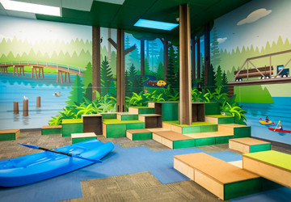
Men’s DIVISION-western Washington maximum, medium, & minimum
Stafford Creek Corrections Center (Aberdeen, WA)
Courtesy of WA DOC, LinkedIn, 2025
Notes:
Grays Harbor County
Capacity: 1,936
Opened 2000

Slide 12
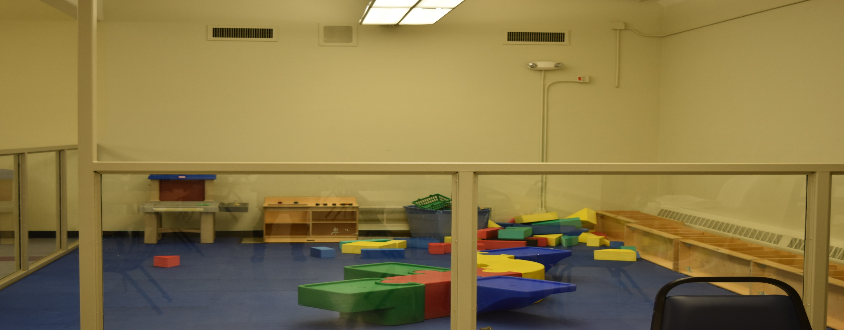
Men’s DIVISION-western Washington maximum, Close, & medium
Washington Corrections Center (Shelton, WA)
Courtesy of WA DOC Family Services Division, 2018
Notes:
Mason County
Capacity: 1,268
Opened 1964

Slide 13
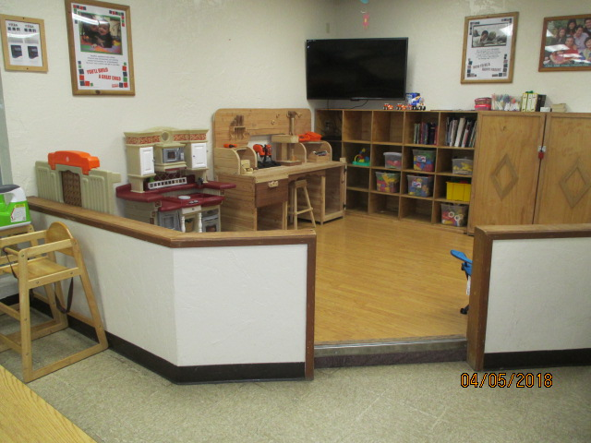
Men’s DIVISION-western Washington minimum
Olympic Corrections Center (Forks, WA)
Courtesy of WA DOC Family Services Division, 2018
Notes:
Jefferson County (west of Olympic National Park)
Capacity: 381
Opened 1968

